Slide 1
The Pain Management
Centre
Burwood Hospital
Simon Goss – Clinical Psychologist
Dr John Alchin - FFPMANZCA

Slide 2
Today’s Presentation
Simon:
Our service
Model of care
Treatment approach to chronic pain
Considerations for neuromuscular disorders
John:
Mechanisms of chronic pain
Pain & the brain
Medications
Notes:
Reminders: Not expert on NMD, won’t be a talk on the specifics of pain in NMD, but emphasise that the core aspects of treatment don’t tend to differ between the wide variety of conditions we see anyway!
My experience trying to find resources/research.

Slide 3
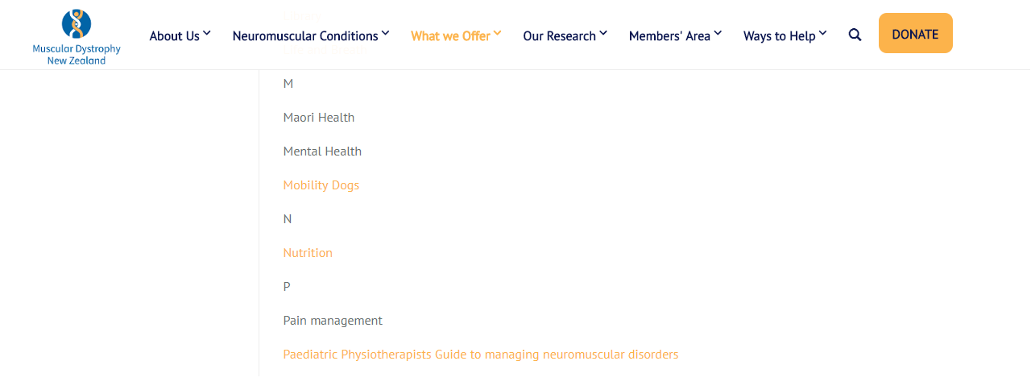

Slide 4
Our Service
An interdisciplinary approach, tailored to meet the complex needs of individuals with chronic pain.
Our key objectives include:
To improve understanding of chronic pain
To maximise individual functioning and enhance quality of life
To promote self-management to increase personal skills and productive activity
Pain Management involves learning different ways of thinking and acting so that pain interferes less with life. A self-management approach requires an individual to play an active role in their pain management, and emphasises an improvement in quality of life and function, rather than a cure.
Notes:
Defining “interdisciplinary” – on next slide
Not aiming for a cure, and not even explicitly aiming for a reduction (ie on a numerical scale).
Emphasising increased quality of life, which can often lead to a reduction in the intensity of a person’s pain experience!

Slide 5
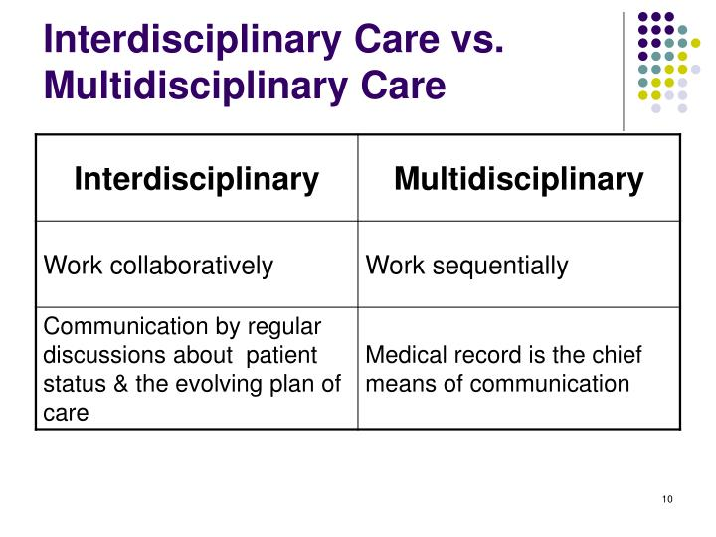
Our Team
Administrators and Clerical Staff 4
Clinical Psychology 4
Medical 7
Nursing 4
Occupational Therapy 3
Physiotherapy 3
Social Work 1
Notes:
In a multi-disciplinary team you might see members of professions, however they will usually work separately from each other, and don’t tend to apply joint problem solving to a patient’s problems. Interdisciplinary teams work on shared goals in a collaborative manner, with both patients and other team-members.
Often this can mean shared sessions (for instance, with a physiotherapist and psychologist).

Slide 6
Chronic Pain
Chronic pain = “persistent or recurrent pain lasting > 3 months”
“Chronic primary pain is pain in 1 or more anatomic regions that persists or recurs for longer than 3 months, is associated with significant emotional distress or significant functional disability (interference with activities of daily life and participation in social roles), & cannot be better explained by another chronic pain condition.”
Chronic pain is common in the neuromuscular disorders
- In a sample of 257 patients with either Myotonic Muscular Dystrophy or Fascioscapulohumeral Muscular Dystrophy, 82% of FSHD reported chronic pain, and 64% of MMD.
- In a sample of 193 adults with NMD, 73% reported chronic pain.
Jensen, M. P., Hoffman, A. J., Stoelb, B. L., Abresch, R. T., Carter, G. T., & McDonald, C. M. (2008). Chronic pain in persons with myotonic dystrophy and facioscapulohumeral dystrophy. Archives of physical medicine and rehabilitation, 89(2), 320-328.
Jensen, M. P., Abresch, R. T., Carter, G. T., & McDonald, C. M. (2005). Chronic pain in persons with neuromuscular disease. Archives of physical medicine and rehabilitation, 86(6), 1155-1163.
Notes:
NMD included myopathies (such as muscular dystrophies), disorders of the neuromuscular junctions (such as myasthenia gravis) and neuropathies (such as Guillain-Barré syndrome).
In the general population you’re looking at around 1 in 5 people, so it seems pretty clear that there are increased rates of chronic pain in the NMDs.

Slide 7
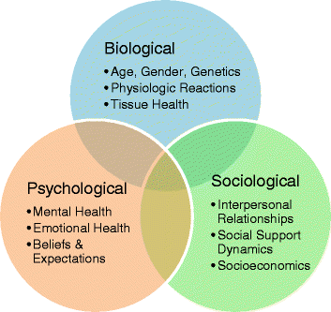
The Biopsychosocial Model
Biomedical Model:
Reductionist, looks for single-factor causes of illness, rather than contributing factors.
Focuses on illness, not health.
Biopsychosocial Model:
Holistic – encompasses individual biology, culture, psychological factors, relationships with others.
Does not focus on single causes – assumes that health and illness have many causes and effects
Address changeable factors that contribute to overall wellness

Slide 8
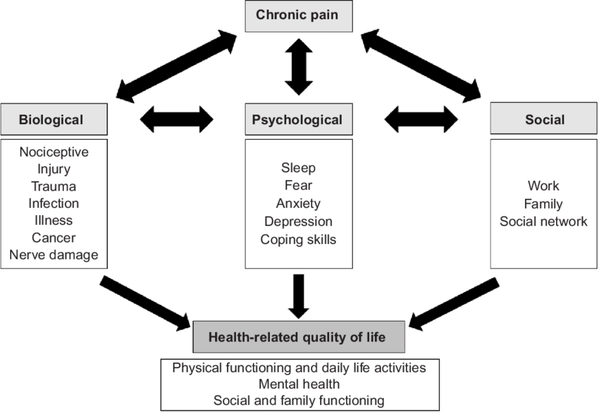
Why biopsychosocial?
Notes:
Managing the entire experience of chronic pain – biomedical treatment is unlikely to be successful in improving functional ability if all the other domains are ignored.
Start to fill in roles of different practitioners relating to diagram..
Key message = maximising independence, with strategies for the management of pain, fatigue, and associated features.
Re: depression/anxiety – pain is not psychological, but can contribute and be affected by etc etc.
Reiterate social aspect – have social supports that can help with strategies and understand the rationale for their importance.

Slide 9
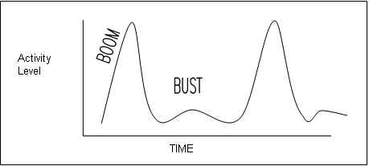
Strategies: Activity Patterns
Fear-avoidance
Boom-bust
Pain contingent

Slide 10
Aim: Paced, consistent level of activity
Notes:
This can be for exercise, tasks around the home, and life in general.
This often will include physiotherapy work (examples), OT work (examples), psychological work (examples), etc.
Useful for not just pain, but fatigue.

Slide 11
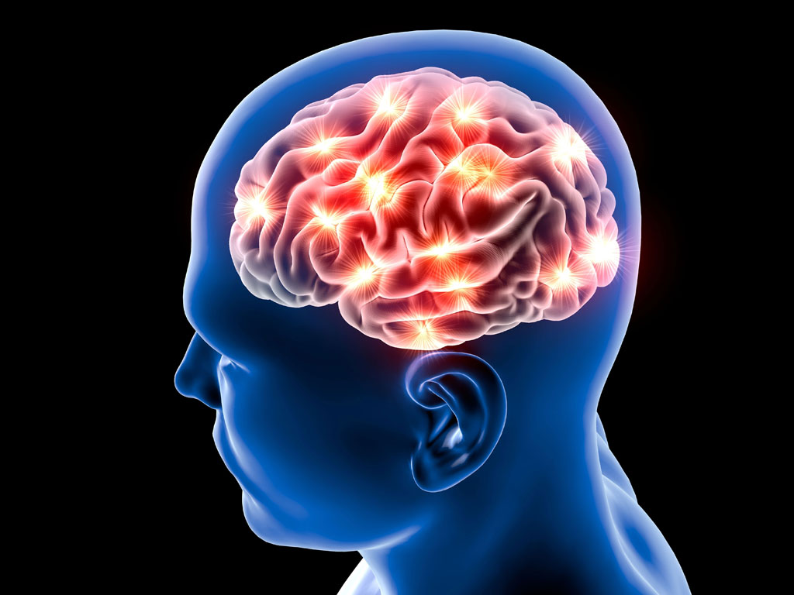
Strategies: Psychological Factors
“Is it all in my head?”
- No! But… yes. But not in the way you mean.
- Unless you’re very, very talented, your brain is probably in your head. Your brain is where you experience pain.
- Chronic pain is not a psychological illness
- All pain comes from your brain
- Psychological factors have a two way relationship with pain:
Mood/anxiety/emotions/beliefs → affect pain
Pain affects → mood/anxiety/emotions/fear
Notes:
Mood, anxiety
Relaxation/stress management
Emotions, cognitions, beliefs all play a role in the way that pain is experienced.
Not all in head, not all physical! Multitude of factors that contribute to the pain experience.
Sleep hygiene (poor sleep predictive of increased pain, more significantly than pain disrupting sleep)

Slide 12
Strategies – Psychological Factors
Beliefs about pain
Low mood
Anxiety
Stress management
Relaxation
Sleep
Cognitive Behavioural Therapy (CBT)
Biofeedback
Sleep Hygiene
Pain education
Goal Setting
Mindfulness, breathing, other relaxation strategies

Slide 13
Comparing “standard” Chronic Pain Therapies vs in NMDs
(There is no “standard” treatment! Always individual differences, physical, psychological, social and cultural)
Similarities
- Focus upon maximising independence, regardless of physical capabilities
- Biopsychosocial, holistic framework
- Based on neuropsychological evidence– we know that the strategies we use create change in the brain
- Core domains are the same: pain education, movement/exercise, psychological aspects of pain, nutrition, social engagement.
Differences
- Increased focus on working with aids, assistive technologies & social supports
- Liaison between other treating medical professionals
- Need to be more mindful of physiological limits/ceilings
- Specific strategies (to manage swelling, cramping, spasms)
- May need to pay more attention to changing strategies over time
Notes:
Emphasis is not just on moving areas that are weak and in pain – brain systems
Think – different “levels” of need, involvement of others, modification of strategies based on progressive disease/disorder.
Because disease can progress and change, the way strategies are used (or even which ones are used) can change!
Focus upon core domains – movement/exercise, nutritional, social, psychological, etc.

Slide 14
These strategies are beneficial for more than pain!
People who attend our BASE seminar report that the strategies they start using for pain tend to have effects on other areas of life too (weight loss, overall mood, better sleep). This is likely to be the case for NMD, too.
Relaxation – Beneficial for acute pain, managing distress, anxiety
Exercise – Confidence, self-esteem, range of movement, better sleep, stiffness
Nutrition – Bowel management, fatigue
Sleep Hygiene – Mood, fatigue, energy levels
Notes:
Symptoms and strategies that can help both pain and other aspects of NMD: Strategies not just for pain! People who come to BASE response to strategies – help with weight, mood, etc etc
Sleep Hygiene –
Exercise –
Relaxation -Acute pain, chronic pain, distress, anxiety
Nutrition – Pain, bowel,
Social engagement

Slide 15
Resources
HealthInfo Canterbury
http://www.healthinfo.org.nz/
Pain Network website – pain bytes (videos for adults and youth)
http://www.aci.health.nsw.gov.au/chronic-pain
Retrain Pain
http://www.retrainpain.org/
Tame the Beast
https://www.tamethebeast.org/
Explain pain in less than 5 minutes – search for this on Youtube
Hunter Integrated Pain Service – great resources!
http://www.hnehealth.nsw.gov.au/Pain/Pages/Community-resources.aspx

Slide 16
PAIN
Muscular Dystrophies & Pain
Simon Goss, Clinical Psychologist
Dr John Alchin, FFPMANZCA
Pain Management Centre, Burwood Hospital, Christchurch
29th September 2018

Slide 17
Definition of pain
(IASP, 1979)
  “Pain is an unpleasant sensory & emotional experience associated with actual or potential tissue damage, or described in terms of such damage”
NB: suffering.
Proposed new definition for discussion (Pain 157; 2016; 2420–2423) :
  “Pain is a distressing experience associated with actual or potential tissue damage with sensory, emotional, cognitive, and social components”

Slide 18
Mechanistic Pain Descriptors 1
Nociceptive Pain
Pain due to threatened or actual tissue damage causing activation of normally functioning nociceptors.
This is the nociceptive system functioning as intended.
2 types:
High intensity stimulus in the absence of inflammation, eg a foot put in an unexpectedly very hot bath – protective function
Low intensity stimulus in the presence of inflammation, eg sunburn – healing function

Slide 19
Mechanistic Pain Descriptors 2
Neuropathic Pain
Pain caused by a lesion or disease of the somatosensory nervous system.
Central
SCI pain;
MS related pain;
post stroke pain
Peripheral
Radiculopathy / radicular pain, entrapment neuropathies
Post-herpetic neuralgia
Painful diabetic peripheral neuropathy
Chronic post-surgical neuropathic pain

Slide 20
Mechanistic Pain Descriptors 3
Nociplastic Pain
(= “nociceptive plasticity,” i.e. pathological change in function of nociceptive pathways). A new term introduced (IASP, December 2017) to describe pain states characterized by clinical and psychophysical findings that suggest altered nociception, with:
No evidence of actual or threatened tissue damage causing the activation of normally functioning nociceptors; or
No evidence for disease or lesion of the somatosensory system causing the chronic pain.

Slide 21
Mechanistic Pain Descriptors
In nociceptive pain, the alarm is functioning as it should, warning the organism of problems, or potential problems, in the periphery.
In contrast, neuropathic and nociplastic pain are “alarm” system problems, not problems with the peripheral tissues where the pain is felt. They are a “false alarm.”

Slide 22
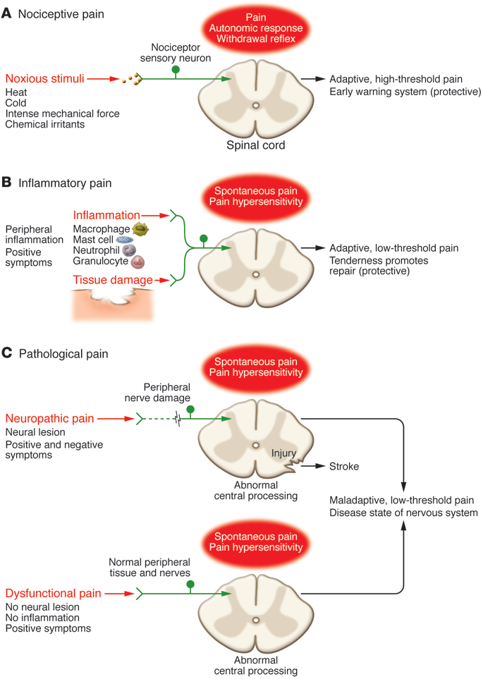
(Woolf, 2010)
Notes:
Pain classification. Pain can be broadly divided into three classes. (Woolf, 2010)
(A) Nociceptive pain is the sensation associated with the detection of potentially tissue-damaging noxious stimuli, and is protective.
(B) Inflammatory pain is associated with tissue damage and the infiltration of immune cells, and can promote repair by causing pain hypersensitivity until healing occurs.
(C) Pathological pain is a disease state caused by damage to the nervous system (neuropathic), or by its abnormal function (dysfunctional).

Slide 23
International Classification of Diseases version 11 (ICD-11)
Launched on 18 June 2018 (“ICD-11: a brave attempt at classifying a new world”. Editorial. Lancet, 23.6.18, page 2476)
MG30 Chronic pain
Chronic pain is pain that persists or recurs for longer than 3 months.
MG30.0 Chronic primary pain
Chronic primary pain is chronic pain in one or more anatomical regions characterized by significant emotional distress (anxiety, anger/frustration or depressed mood) or functional disability (interference in daily life activities and reduced participation in social roles). Chronic primary pain is multifactorial: biological, psychological and social factors contribute to the pain syndrome.
1.1. Widespread chronic primary pain (including fibromyalgia)
1.2. Localized chronic primary pain (including nonspecific back pain, chronic pelvic pain)

Slide 24
International Classification of Diseases version 11 (ICD-11)
MG30.1 Chronic cancer related pain
MG30.2 Chronic post-surgical or post-traumatic pain
MG30.3 Chronic secondary musculoskeletal pain
MG30.4 Chronic secondary visceral pain
MG30.5 Chronic neuropathic pain
MG30.6 Chronic secondary headache or orofacial pain

Slide 25
PHYSIOLOGY – KEY POINTS
Pain as an output of the brain
Nociceptive (“pain”) system as a sub-division of the nervous system (peripheral & central)
The concept of disorders of the nociceptive system; in particular:
The importance of central neural sensitisation – ie, sensitisation of the nociceptive pathways in the CNS

Slide 26
MEDICAL MYSTERIES 1
BUILDERS, NAILS, & PAIN

Slide 27
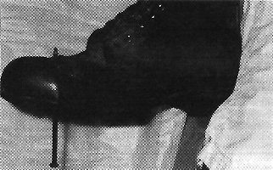

A builder aged 29 came to the accident and emergency department having jumped down on to a 15 cm nail. As the smallest movement of the nail was painful he was sedated with fentanyl and midazolam. The nail was then pulled out from below. When his boot was removed a miraculous cure appeared to have taken place. Despite entering proximal to the steel toecap the nail had penetrated between the toes: the foot was entirely uninjured.--J P FISHER, senior house officer, D T HASSAN, senior registrar, N O'CONNOR, registrar, accident and emergency department, Leicester Royal Infirmary.
Fisher, J P et al. BMJ 1995;310:70
Copyright ©1995 BMJ Publishing Group Ltd.

Slide 28
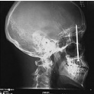
Neurotransmitters
Somatic Deamplification. Reprinted from Associated Press, World Wide Photos
1/16.05.
USA Today described a construction worker who had unknowingly shot himself in the head with a nail gun, & was unaware of the injury. Due to a toothache he attended a dentist 6 days later, where the cause of the toothache was discovered. Dimsdale JE, Dantzer R: 2007
Notes:
USA Today described a construction worker who had unknowingly shot himself in the head with a nail gun, & was unaware of the injury. Due to a toothache he attended a dentist 6 days later, where the cause of the toothache was discovered. Dimsdale JE, Dantzer R: 2007

Slide 29
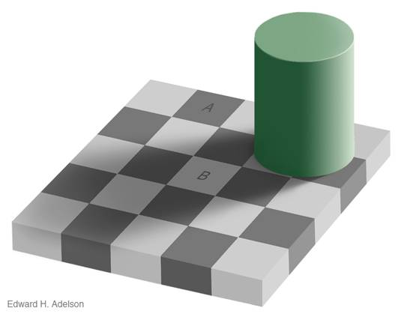
MEDICAL MYSTERIES 2

Slide 30
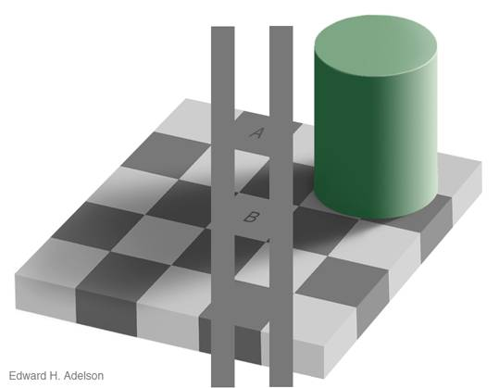

Slide 32
MEDICAL MYSTERIES EXPLAINED
PAIN (& VISION) AS OUTPUTS OF THE BRAIN

Slide 33
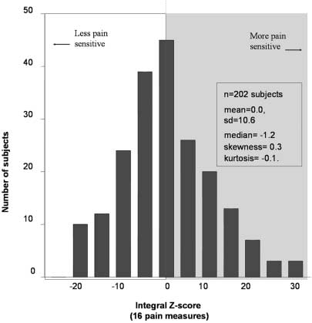
Pain Perception is Normally Distributed
Diatchenko et al: Human Molecular Genetics, 2005, Vol. 14, No. 1; pp 135–143
Notes:
Distribution of a summary measure of pain sensitivity in 202 healthy females aged 18–34 years, derived from 16 individual pain measures: thermal pain threshold, arm ischaemic pain onset and tolerance; and mechanical pain thresholds (kg): temporalis & masseter muscles, TMJ, wrists.

Slide 34
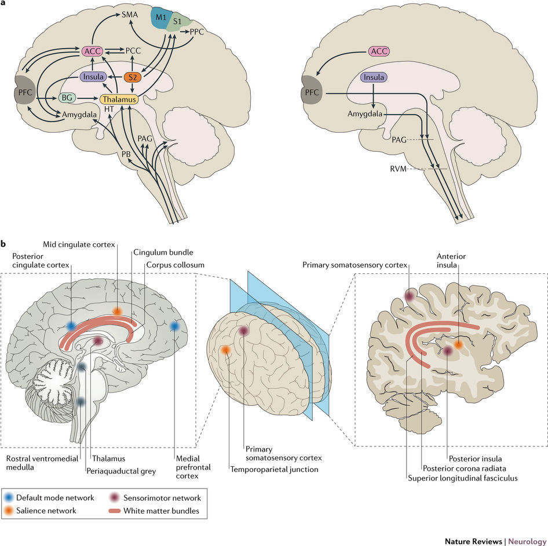

Slide 35
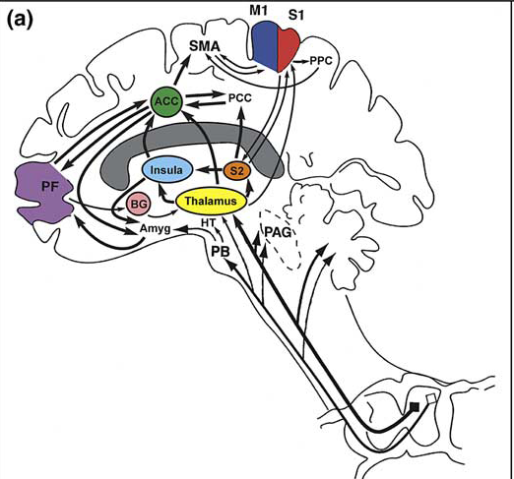
Cortical and sub-cortical regions involved in pain perception, their inter-connectivity and ascending pathways. Locations of brain regions involved in pain perception are color-coded in a schematic drawing and in an example MRI. (a) Schematic shows the regions, their inter-connectivity
and afferent pathways.

Slide 36
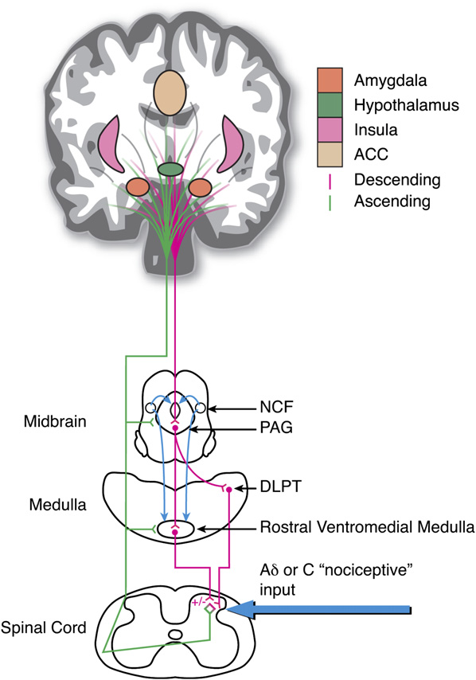
The Descending Pain Modulatory System
NCF (nucleus cuneiformis); PAG (periaqueductal gray); DLPT (dorsolateral
pontine tegmentum); ACC (anterior cingulated cortex); +/ indicates
both pro- and anti- nociceptive influences, respectively.

Slide 37
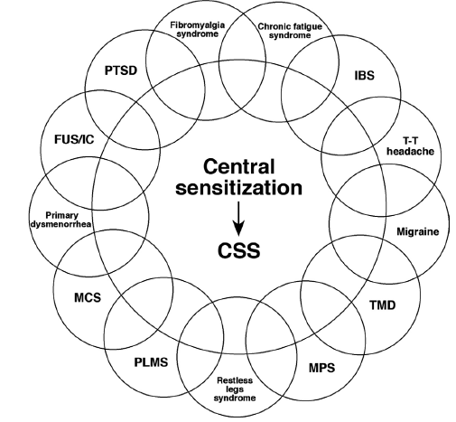

(Yunus, 2007, 341) Also – non-cardiac chest pain; chronic abdominal / pelvic pain; vulvodynia

Slide 38
Chronic Pain in Muscular Dystrophies
Common
Differences in different types
More research needed into types of pain, & their treatment

Slide 39
Chronic Pain in Muscular Dystrophies
Types of Chronic Pain:
Nociceptive – postural (immobility) & muscle spasm → dull muscular ache:
  Constant low level exercise in dystrophic mouse muscle → damage (necrosis)
  Significant decrease in tetanic & twitch/tension contraction time
  Concentric injury → slow oxidative fibre damage
  Eccentric injury → fast glycolytic fibre damage
  Also - ? ischaemia?
Nociplastic (chronic musculoskeletal pain disorder)
? Neuropathic

Slide 40
BIOMEDICAL MANAGEMENT– KEY POINTS
Empirical
Nor-adrenergic ADs & gabapentinoids
Limited Role of Opioids
Analgesic Report Card: C minus →
Interdisciplinary pain self-management essential (could include CBT, exercise)
Ie, Biopsychosocial (socio-psycho-biomedical) model

Slide 41
Drug Treatment of Chronic Pain – Principles
Moore A, Derry S, Eccleston C, Kalso E: “Expect Analgesic Failure; Pursue Analgesic Success”. British Medical Journal; BMJ 2013;346:f2690 (Published on-line 3 May 2013; print edition 08.06.13)
Doi: http://dx.doi.org/10.1136/bmj.f2690
See also R. Andrew Moore: “Review. What works for whom? Determining the efficacy and harm of treatments for pain”; Pain 154 (2013) S77–S86

Slide 42
Evidence for analgesic efficacy
Evidence for analgesic efficacy (those with a success rate > 50%) in 4 types of pain
(“success” = 50% or more pain reduction in 50% or more of those randomised to active drug)
Acute postoperative pain – only 4 of 10 analgesics.
Acute migraine – only 1 of 6 medications
Chronic musculoskeletal pain (osteoarthritis, chronic low back pain, fibromyalgia, ankylosing spondylitis) – none of 19 medications
Neuropathic pain (painful diabetic neuropathy, post-herpetic neuralgia) – none of 9 medications
Message: Very sobering. No Triumphalism. Be realistic. “Expect Analgesic Failure.”

Slide 43
Analgesia not normally distributed
“Pain relief is not normally distributed, but usually bimodal, being either very good (> 50%) or poor (< 15%).”
That is, any given analgesic tends to either:
Work quite well (but only in a small minority of patients – 10-15%);
or
Not work at all (in 85-90% of patients).

Slide 44
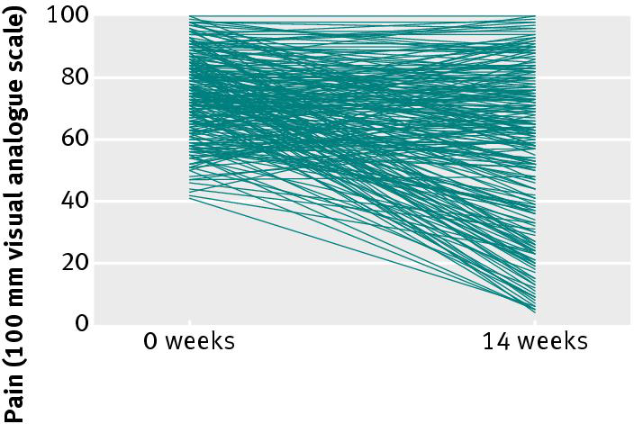
Fig 1 Individual changes in pain over 14 weeks of treatment with pregabalin 450 mg in 200 patients with fibromyalgia

Slide 45
Responders vs Non-Responders
Responders: (a minority)
“success is often achieved within the first 2 weeks or so of treatment or not at all, & … tends to last.”
“Those who get better (responders) do well: recent individual patient analyses for chronic pain interventions have shown that people who respond experience improvements in fatigue, depression, and sleep … & general measures of function and quality of life, including ability to work.”
Non-responders (the majority)
“have none of these benefits.”

Slide 46
“Average benefits have no part in these discussions.”
“Using averages is unhelpful and misleading, because ‘average’ pain relief is actually experienced by few (if any) patients, and it tells us nothing about how many patients will experience clinically useful pain relief.”

Slide 47
Minimises Side-Effects
An important advantage of this “responder analysis” approach to assessing analgesic efficacy is that it minimises patient exposure to adverse drug effects:
In the (likely) event of analgesic trial failure, “patients without benefit should be exposed to no risk, because the drug is stopped; only effective drugs should continue to be prescribed.”
On the other hand, “With success, considerable benefits in terms of pain relief, sleep, fatigue, depression, function, and quality of life, are balanced against rare risk of serious harm.”

Slide 48
Explanation & Implications
These disappointing results not unexpected:
“Chronic pain conditions are complex, and associated with considerable comorbidity. Coupled with the intricacies of pain modulation, central nervous system changes, and genetic influences, high failure rates with single interventions are unsurprising.”
The “magnitude of the failure to achieve good pain relief, especially over the longer term in chronic pain, is sobering”
Requiring
“a radical rethink of achievable analgesic effects”.

Slide 49
Analgesics have a ‘very’ limited role
“The analgesic effects of many treatments for non-specific low back pain are small”
(Machado LAC et al: “Analgesic effects of treatments for non-specific low back pain: a meta-analysis of placebo-controlled randomized trials”; Rheumatology 2009; 48:520–527)
“A common key finding in the literature on these interventions for CLBP is their disappointing magnitude of pain reduction & gain in functionality”
(Morlion B: “Chronic low back pain: pharmacological, interventional & surgical strategies”; Nat. Rev. Neurol. 2013: 9, 462–473)

Slide 50
Analgesics have a ‘very’ limited role
“from 1960 to 2009 ... Very intensive research efforts directed at diverse molecular targets related to pain mechanisms produced thousands of publications, but those efforts have not yet yielded new analgesics with sufficient effectiveness ... lack of real breakthroughs in analgesic drug development despite intense research efforts.”
(Kissin, I: “SPECIAL ARTICLE: The Development of New Analgesics Over the Past 50 Years: A Lack of Real Breakthrough Drugs”; Anesth Analg; 2010;110:780 –9)

Slide 51
Analgesics have a ‘very’ limited role
“Most existing analgesics for persistent pain are relatively ineffective … the number of patients who are needed to be treated (NNT) to achieve 50% reduction in neuropathic pain in one patient is more than four”.
Woolf, C: “Review: Overcoming obstacles to developing new analgesics”; Nature Medicine (Supplement); 16,11: 1241 – 47; November 2010

Slide 52
Analgesics have a ‘very’ limited role
“Overall, present treatment options result in modest improvements at best, & part of chronic pain management should include dialogue with the patient about realistic expectations of pain relief, & bring focus to improvement of function … Of all treatment modalities reviewed, the best evidence for pain reduction averages roughly 30% in about half of treated patients ...
Turk DC, Wilson HD, Cahana A: “Treatment of Chronic Non-Cancer Pain”, The Lancet 2011; 377: 2226–35 (25.6.11)

Slide 53
Analgesics have a ‘very’ limited role
. . . none of the most commonly prescribed treatment regimens are, by themselves, sufficient to eliminate pain & to have a major effect on physical & emotional function in most patients with chronic pain. This conclusion is hardly surprising in view of the complexity of chronic pain. … If there is no ... improvement in patient pain, physical & emotional functioning, then an alternate treatment approach should be recommended.”
Turk DC, Wilson HD, Cahana A: “Treatment of Chronic Non-Cancer Pain”, The Lancet 2011; 377: 2226–35 (25.6.11)

Slide 54
Analgesics have a ‘very’ limited role
In terms of biomedical treatments to reduce pain intensity:
“If one were to review “effective” treatments for back pain, the picture would be rather large, but perhaps somewhat underwhelming. There is now a massive body of randomized controlled trials (RCTs), systematic reviews, and meta-analyses on treatments for back pain
… treatments that do exist, regardless of the discipline that offers them, & regardless of their provenance, offer on average a small benefit or no benefit at all, aside from the nonspecific effects of treatment”.
(Moseley GL: “Innovative treatments for back pain”; Pain Supplement April 2017; pp 2–10)

Slide 55
NP - MEDICATION MANAGEMENT
Lancet Neurology, Feb 2015; 162-73
Finnerup NB et al: “Pharmacotherapy for neuropathic pain in adults: a systematic review & meta-analysis”, for NeuPSIG, IASP
(Edit comment: Bennett DL; 129-30)
Previous iterations:
Pain December 2007, 237-51
Arch Neurol November 2003, 1524-34

Slide 56
MEDICATION MANAGEMENT
Lancet Neurology, Feb 2015; 162-73
MAIN CONCLUSION (page 169)
“Based mainly on moderate or high quality of evidence and efficacy in most trials”, TCAs, gabapentinoids, & SNRIs, are recommended “for use in neuropathic pain, and are proposed as first-line treatments”

Slide 57
Strong Recommendations – 1st-Line
Dose (mg/day) NNT
Tricyclic ADs 25-150 3.6
  Nortriptyline (fewer side-effects than amitriptyline)
Gabapentin 1200-3600 7.2
Pregabalin 300-600 7.7
Duloxetine 60-120 6.4 (not funded)
Venlafaxine 150-225 6.4
Ie, 3 classes of 1st-line pharmacotherapy for NP:
TCAs, gabapentinoids, SNRIs
(Finnerup NB et al: “Pharmacotherapy for neuropathic pain in adults: a systematic review & meta-analysis”. Lancet Neurol, Feb 2015; 162–73)

Slide 58
Medication Combinations
TCA + Gabapentinoid:
  Nortriptyline + gabapentin (The Lancet; 10.10.09, pp 1252 – 61)
  Imipramine + pregabalin (Pain, May 2015, pp 958-66)
SNRI + Gabapentinoid:
  Venlafaxine + gabapentin (J Clin Neuromuscul Dis; 2001; 3: 53–62)
  Duloxetine + Pregabalin (Pain, July 2016, pp 1532–1540)
See also:
  Mao et al: J Pain, Feb 2011, 157-66
  Gilron et al: Lancet Neurology, Nov 2013, 1084-95

Slide 59
Weak Recommendations – 2nd-Line
Dose (mg/day) NNT
Capsaicin 8% patch 10.6
(PNP) (30-60 mins every 3 months)
Lignocaine 5% patch
(PNP) (Max: 3 patches, up to 12 hours/day)
(Demoted from 1st-line due to “weak quality of evidence”)
Tramadol 200-400 4.7

Slide 60
Recommendations against use:
(Negative Trials &/or Safety Concerns)
Weak recommendations against use:
• Cannabinoids (“negative results, potential misuse, diversion, & long-term mental health risks”)
• Valproate
2. Strong recommendations against use:
• Levetiracetam
• Mexiletine

Slide 61
Other comments
“for individual drugs … NNT for 50% pain relief ranging from about 4 to 10 for most positive trials emphasise the modest overall study outcomes … Inadequate response to drug therapy constitutes a substantial unmet need” … & “might have important consequences in terms of psychological or social adjustment”
“efficacy of systemic drug treatments is generally” independent of aetiology of “underlying disorder”
“generally no evidence of efficacy of particular drugs in specific disorders” → “recommendations apply to neuropathic pain in general”

Slide 62
No Evidence in Neuropathic Pain for:
Anti-inflammatories
Vo, T et al: “Topical review: Non-steroidal anti-inflammatory drugs for neuropathic pain: How do we explain continued widespread use?” Pain; 143 (2009) 169–71
Paracetamol
NB: WHO Analgesic Ladder does not apply to chronic non-malignant pain, including neuropathic pain.

Slide 63
“Oral nonsteroidal anti-inflammatory drugs for neuropathic pain.”
Moore RA et al: Cochrane Review; 2015
third tier evidence, very low quality.
No indication of any significant pain reduction with NSAIDs.
no good evidence whether oral NSAIDs are helpful to treat neuropathic pain
Adverse event rates were low, with insufficient events for any analysis

Slide 64

Paracetamol

Slide 65
Paracetamol – References
Williams CM et al: “Efficacy of paracetamol for acute low-back pain: a double-blind, randomised controlled trial”; Lancet 2014; 384: 1586–96
Brune K: “Review: Acetaminophen/paracetamol: a history of errors, failures and false decisions”; Eur J Pain 19 (2015), 953—965
da Costa BR: “Effectiveness of non-steroidal anti-inflammatory drugs for the treatment of pain in knee and hip osteoarthritis: a network meta-analysis”; Lancet 2017; 390: e21–33
Machado GC et al: “Efficacy and safety of paracetamol for spinal pain and osteoarthritis: systematic review and meta-analysis of randomised placebo controlled trials”; BMJ 2014;350:h1225doi: 10.1136/bmj.h1225
Roberts E et al: “Extended Report: Paracetamol: not as safe as we thought? A systematic literature review of observational studies”; Ann Rheum Dis. 2016;75:552–559.

Slide 66
Moore RA, Moore N: “Paracetamol & pain: the kiloton problem”; Eur J Hosp Pharm. published online April 27, 2016
Discovered in the 1950s
European paracetamol sales: from < 200 tons in Greece & Portugal, to 6300 tons in UK and 10 000 tons in France
Per capita range: 4–5 tons to 30–50 tons per million
Considerable uncertainty over how it works. Only recently accepted that it “inhibits COX-1 and COX-2 isoenzymes, and is in fact a weak NSAID”
“considerable evidence that, as well as not being particularly effective, neither is it particularly safe”

Slide 67
Moore RA, Moore N: “Paracetamol & pain: the kiloton problem”; Eur J Hosp Pharm. published online April 27, 2016. Efficacy:
500 to 1000 mg: in the least effective quartile of drugs for acute post-op pain
1000 mg: modest efficacy in migraine & TTH
Up to 4000 mg daily ineffective in back pain
Up to 4000 mg daily practically ineffective in OA: marginally better than placebo, but little chance of achieving clinically meaningful benefit in osteoarthritis
No review evidence for neck pain, cancer pain, dysmenorrhoea, rheumatoid arthritis

Slide 68
“Efficacy of paracetamol for acute low-back pain: a double-blind, randomised controlled trial”
Williams CM et al: Lancet, Vol 384; 1 November 2014; pp 1586-96
CT of acute low-back pain in 235 primary care centres in Sydney,
Randomised 1:1:1 to receive up to 4 weeks of:
  regular paracetamol 4 gm daily (550 participants → 550 analysed)
  as-needed paracetamol, maximum 4gm daily (549 → 546 analysed)
  placebo (553 → 547 analysed)
primary outcome: time until recovery from LBP, defined as pain score 0-1/10, sustained for 7 consecutive days.
Results:
Median time to recovery:
17 days (95% CI 14–19) in the regular group,
17 days (15–20) in the as-needed group,
16 days (14–20) in the placebo group
adverse events were similar between groups:
  99 [18·5%] in the regular group,
  99 [18·7%] in the as-needed group,
  98 [18·5%] in the placebo group.

Slide 69
Paracetamol & Acute LBP

Slide 70
R Andrew Moore RA, Moore N: “Paracetamol & pain: the kiloton problem”; Eur J Hosp Pharm. published online April 27, 2016. Safety:
Systematic review of observational studies: vs people not taking it, paracetamol use, especially at higher doses, is associated with:
Increased mortality,
Cardiovascular adverse events:
  Fatal or non-fatal myocardial infarction,
  stroke,
Gastrointestinal adverse events: Gastroduodenal ulcers and complications (upper GI haemorrhage)
Estimated glomerular filtration rate decrease of at least 30 mL/ min/1.73 sq m.

Slide 71
R Andrew Moore RA, Moore N: “Paracetamol & pain: the kiloton problem”; Eur J Hosp Pharm. published online April 27, 2016. Safety:
Chronic pain RCTs: vs placebo, patients on paracetamol four times as likely to have abnormal liver function tests
Large case-population study: non-overdose paracetamol (vs NSAIDs): Acute liver failure needing transplantation twice as common.
Paracetamol had very similar adverse event rates to ibuprofen over 3 months in patients with arthritis, and was not better tolerated than ibuprofen for short-term relief of common pain
Any adverse event in acute pain studies were the same for paracetamol (up to 1000 mg) as placebo.

Slide 72
R Andrew Moore RA, Moore N: “Paracetamol & pain: the kiloton problem”; Eur J Hosp Pharm. published online April 27, 2016. Remaining uses:
“There may of course be circumstances where paracetamol might be useful, in paediatric pain, for treating patent ductus arteriosus, or for intravenous use during surgery.”
“If paracetamol were an unimportant and little-used drug, none of this might amount to much. But it is not. It is a drug whose use is measured in thousands of tons, has little or no effect in many conditions, and has significant adverse events. Maybe it is time to consider the evidence again, and think about the possibility of change.”

Slide 73
“NSAIDs for Chronic Low Back Pain”
Enthoven WTM et al: JAMA 13.6.17; pp 2327-28 (Cochrane Review)
NSAIDs (vs placebo) associated with a small but significant improvement in pain and disability
But this difference became non-significant when studies with high risk for bias were excluded.
The benefits were smaller than the minimal clinically important difference.

Slide 74
The limited role of Opioids
Lack of evidence of long-term efficacy in Chronic pain
Tolerance and Physiological Dependence
Risks of accidental overdose (US “opioid epidemic / crisis”)
Substance Use Disorder
Opioid-Induced Hyperalgesia
Withdrawal from Opioids

Slide 75
The limited role of Opioids
BPMC Opioid Guidelines (unchanged since 1999):
Don’t normally use strong opioids for chronic non-cancer pain
If we do, it’s normally methadone
Never prescribe at first visit – initiate opioids only after discussion at weekly case conference – IDT decision
We do not endorse the prescription of opioids for patients with a diagnosis of SUD – under AOD

Slide 76
Cochrane Review 2018
“Cannabis-Based Medicines for Chronic Neuropathic Pain in Adults”
“potential benefits of cannabis-based medicine in chronic neuropathic pain might be outweighed by their potential harms. The quality of evidence for pain relief outcomes reflects the exclusion of participants with a history of substance abuse and other significant co-morbidities from the studies, together with their small sample sizes.”

Slide 77
“Cannabis & Cannabinoids for the Treatment of People with Chronic Non-
Cancer Pain Conditions: a Systematic Review & Meta-Analysis of Controlled
& Observational Studies”; Stockings E et al: Pain October 2018
Review of Medicinal Cannabinoids
91 publications with 104 studies were eligible (n = 9958 participants), including
  47 RCTs
  57 observational studies.
48 studies examined neuropathic pain,
7 studies examined fibromyalgia,
1 rheumatoid arthritis,
48 other CNCP (13 MS-related pain, 6 visceral pain, & 29 samples with mixed or undefined CNCP)

Slide 78
“Cannabis & Cannabinoids for the Treatment of People with Chronic Non-
Cancer Pain Conditions: a Systematic Review & Meta-Analysis of Controlled
& Observational Studies”; Stockings E et al: Pain October 2018
Analgesic Efficacy
30% reduction in pain:
  29% (cannabinoids) vs 26% (placebo)
  number needed to treat to benefit (NNTB): 24;
50% reduction in pain: no significant difference:
  18.2% (cannabinoids) vs. 14.4% (placebo).
Pooled change in pain intensity (standardised mean difference: -0.14, 95%CI -0.20, -0.08), equivalent to 3mm on a 100mm visual analogue scale greater than placebo

Slide 79
“Cannabis & Cannabinoids for the Treatment of People with Chronic Non-
Cancer Pain Conditions: a Systematic Review & Meta-Analysis of Controlled
& Observational Studies”; Stockings E et al: Pain October 2018
Adverse Events (AEs)
all-cause AEs = 81.2% (cannabinoids) vs. 66.2% (placebo);
number needed to treat to harm (NNTH): 6.
Other Effects of Cannabinoids
No significant impacts upon physical or emotional functioning,
Low-quality evidence of improved sleep, and patient global impression of change.

Slide 80
“Cannabis & Cannabinoids for the Treatment of People with Chronic Non-
Cancer Pain Conditions: a Systematic Review & Meta-Analysis of Controlled
& Observational Studies”; Stockings E et al: Pain October 2018
Conclusions
Evidence for effectiveness of cannabinoids in CNCP is limited.
Moderate evidence for a reduction in pain for cannabinoids compared to placebo:
30% reduction in pain 29% in cannabinoids, vs 26% in placebo groups.
50% reduction in pain 18.2% in cannabinoid groups vs 14.4% in placebo groups (not statistically significant)
NNTB to achieve a 30% reduction in pain for one person using cannabis or cannabinoids (vs placebo) = 24
NNTH for one person to experience any adverse event was 6
That is, NNTB are high, and NNTH low, with limited impact on other domains.
It appears unlikely that cannabinoids are highly effective medicines for CNCP.

Slide 81
CONCLUSIONS of SRs
Weak evidence for efficacy of cannabinoids in neuropathic pain
No or insufficient evidence of efficacy in:
  Chronic musculoskeletal pain
  Headache disorders
  Chronic visceral pain
  Cancer pain
Few & low quality studies, providing insufficient evidence to gain FDA approval
Issue of side effects
Whence the pressure for “medicinal cannabis”?

Slide 82
FPMANZCA
Statement on “Medicinal Cannabis”, in Chronic Non-Cancer Pain, 2018
“The scientific evidence for the efficacy of cannabinoids in the management of people with chronic non-cancer pain is insufficient to justify endorsement of their clinical use in this setting.”

